Slide 2
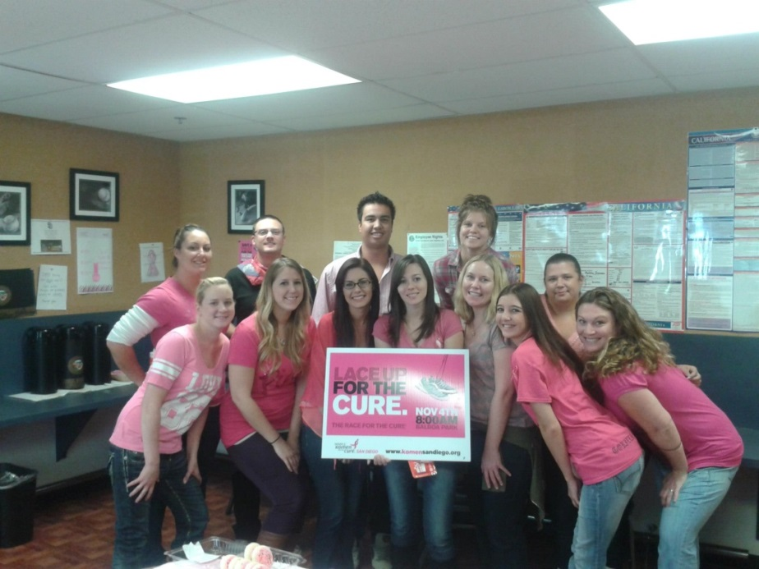
Company Overview
Reputation Impression strives to be your all in one solution for Reputation Management Services. The company was started in 2010, based in San Diego, CA. Our knowledgeable staff is trained to help you optimize your online presence.
Reputation Impression is a family owned business and is a proud member of the San Diego Community.

Slide 3
What is Reputation Management?
Reputation Management is the service that allows you to take control of your online presence including:
Local Optimization
Reviews & Ratings
Negative Removal
Social Media

Slide 4
Local Optimization
Also known as Local Search Optimization, Local Optimization is when we help your business show up on the first page in your local area.
We do this by updating your review directory sites such as Google, Yahoo & Yelp to include targeted keywords & categories, descriptions, photos, hours of operation and other business information.

Slide 5
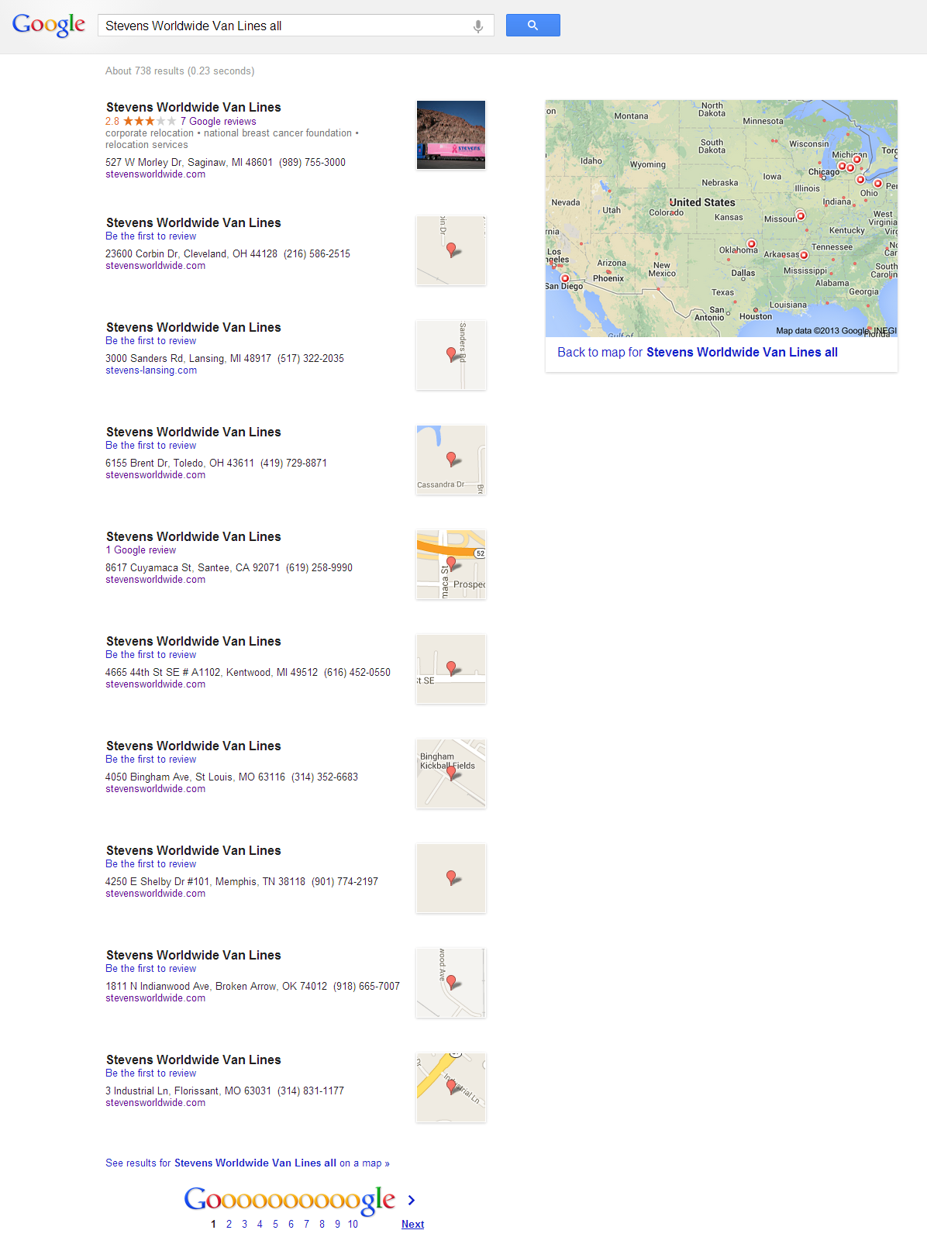
From doing a quick Google Search of the Stevens Worldwide Van Lines locations, the major trend we noticed was that most of the Google Listings for Stevens were unclaimed and not optimized.

Slide 6
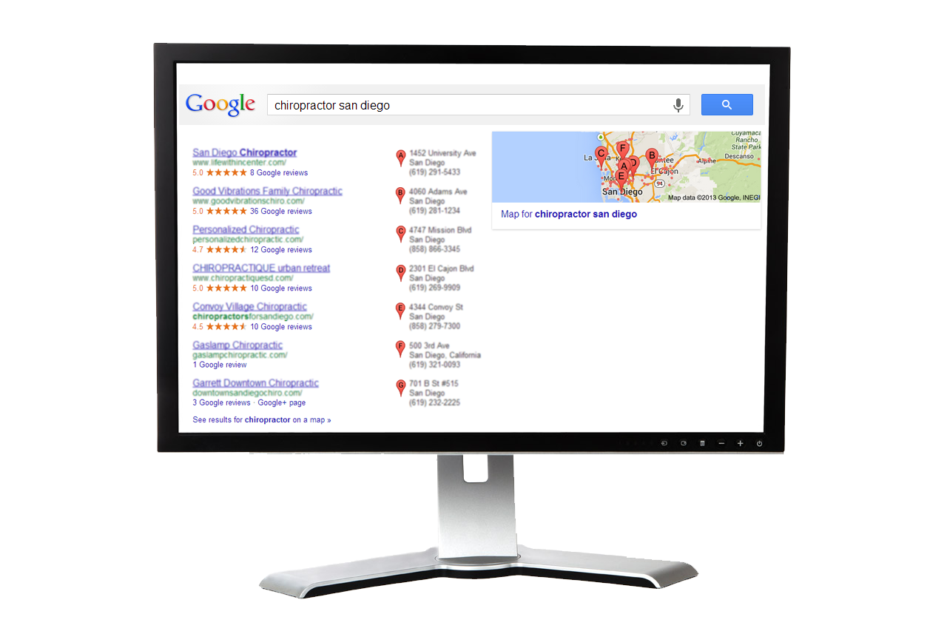
Local Optimization
97% of internet users look for local services online
Businesses on the 1st page of
receive 91.5% of all click through traffic
Source: BIA/Kelsey, User View Wave VII, March 2010
Source: Chitika, The Value of Google Result Positioning, June 2013

Slide 7
Reviews & Ratings
Having a positive online reputation is important to your business’ success.
We provide you the tools to collect positive feedback from your clientele in the form of:
QR Codes
Survey Templates
Email Surveys (options available)
70% of online consumers consult reviews & ratings before purchasing goods or services.
What does Stevens Worldwide affiliates look like online?

Slide 8
Negative Removal
Put a stop to negative content that is old, malicious, or defamatory found on review directory sites
Reputation Impression has an impressive success rate of being able to remove negative content from directory sites.

Slide 9
Social Media
We create your social media sites including: Facebook, Twitter, Google+ & LinkedIn
We post content 4x per month to Facebook & Google+
Facebook has more than 1 Billion active users
Facebook recently updated to allow reviews & ratings on business pages
21% of marketers say that social media has become more important to their company in the past 6 months

Slide 10
What is the cost?
On the Reputation Impression website you will see our regular pricing is as follows:
Premier - $399 per month + $99 set up fee (onetime)
Executive - $599 per month + $99 set up fee (onetime)
We are exclusively offering locations associated with Stevens Worldwide Van Lines the price point:
Premier - $249 per month + no set up fee
Executive - $348 per month + no set up fee

Slide 11
For Example…

